Slide 1
Logistic Regression With R
By Utkarsh Prajapati

Slide 2
Contents
Data set details
Objective
Observations
Recommendations
R Codes
Model Validations

Slide 3
Data Set Details
A snacks manufacturer produces 6 different brands- Brand A, Brand B, Brand C, Brand D, Brand E and Brand F.
Manufacturer is interested in finding out what factors affect the perception for Brand A.

Slide 4
Data Set Details
Data has been collected as a part of a survey exercise done by a snacks manufacturer.
Data Set has 24114 observations with 61 variables.
We are interested only on Brand A and we want to know what factors affect the perception for Brand A.
From data dictionary we have only five relevant variables for brand A.
Our target variable is a rating variable where we collected the customer's rating on a point (10 is consider as good for you and 1 is consider as bad for you).

Slide 5
Objective
We have 4 independent factors:
Zero Trans Fat
Farm grown ingredients
Natural Oils
Minimally processed items
Our job is to figuring out what is the overall perception about Brand A as well as finding out if a specific set of the above factors drive brand perception.

Slide 6
Observations:
50% of the people in survey have rated overall perception of Brand A as 4 or less.
11954 out of 24114 Customer rated 5 or more.
Good perception is increased by 55% if someone has said ‘Yes’ to a question regarding the use of farm grown ingredients.
If someone responds ‘No’ to a question regarding the use of ‘Natural Oils’ then the log odds of that person having a good perception about Brand A will decrease by 40%

Slide 7
Observations
79% of people believed that Brand A is manufactured with farm ingredient.
44% of the people believed that Brand A is manufactured with natural oils.
31% of the people believed that Brand A is manufactured with ingredients having zero-gram trans-fat

Slide 8
Interpretation of the Analysis
If the product are not made from farm ingredient the probability of odd ratio of the rating towards bad is increased by 23%
If the product constantans trans fat then probability of odd ratio of the rating towards bad is increase by 30%.
If the product contains other than naturel oil then probability of bad rating is increase by 34%.
If the product is minimal processed item then probability of good rating is increase by 57%.

Slide 9
Recommendations
Consumer are biased towards farm grown ingredients. Product made from farm grown ingredient can improve customers rating.
Customer rated good who believes that the product contains low trans fat and which are made from natural oils.
The products which are minimally processed are used to believe as good by the customer.
To improve customer satisfaction the product should be:
Made from farm grown ingredients and natural oils.
Does not contains trans fat.
Product should be minimally processed.

Slide 10
R Code
By Utkarsh Prajapati

Slide 11
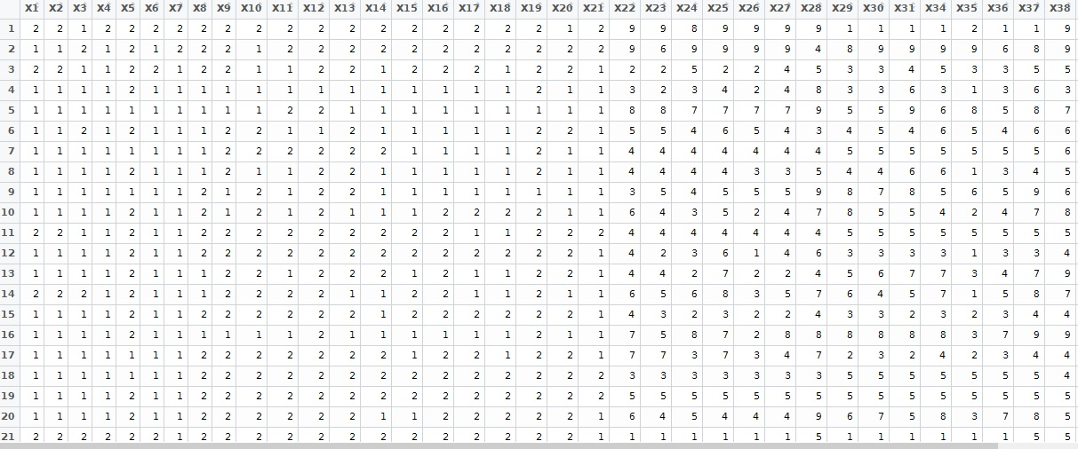
Reading the data from source file
R-Code:
Data Set: partial view

Slide 12

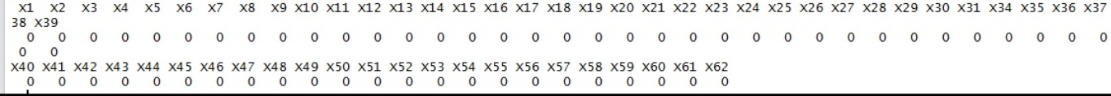
Check for missing values
No missing value found:

Slide 13

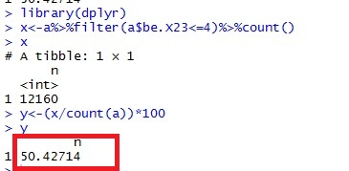
50% of the people in survey have rated overall perception of Brand A as 4 or less
Code:
Output

Slide 14

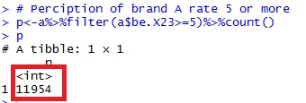
How many respondents have a good perception about brand A? Considering rating 5 or above is good
R Code
Output

Slide 15
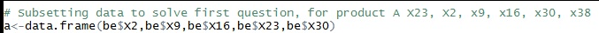

Sub setting the data set
Removing the duplicate column

Slide 16

Divide the data in to test and training data sets
R Code:

Slide 17
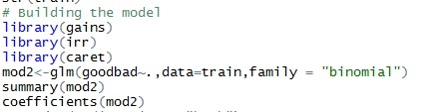
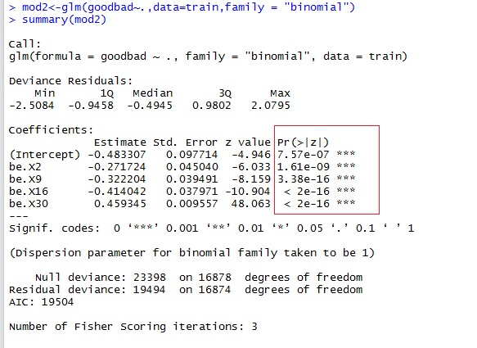
Building the regression model
R Code:
Output: Summary
All the variables are significant.
Residual Deviance has reduced.

Slide 18
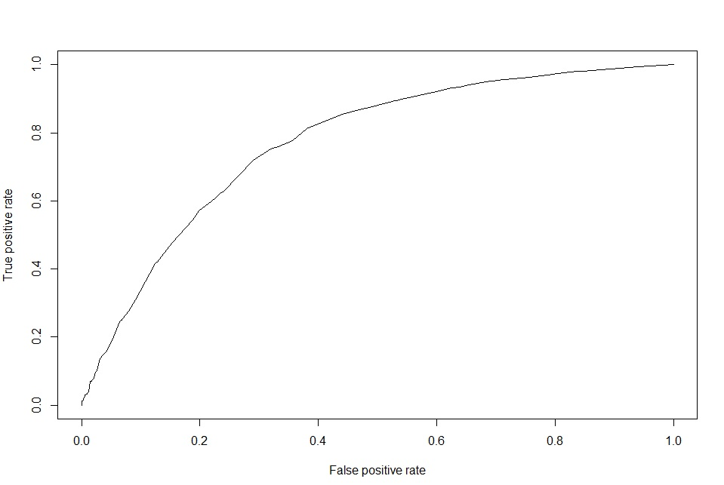
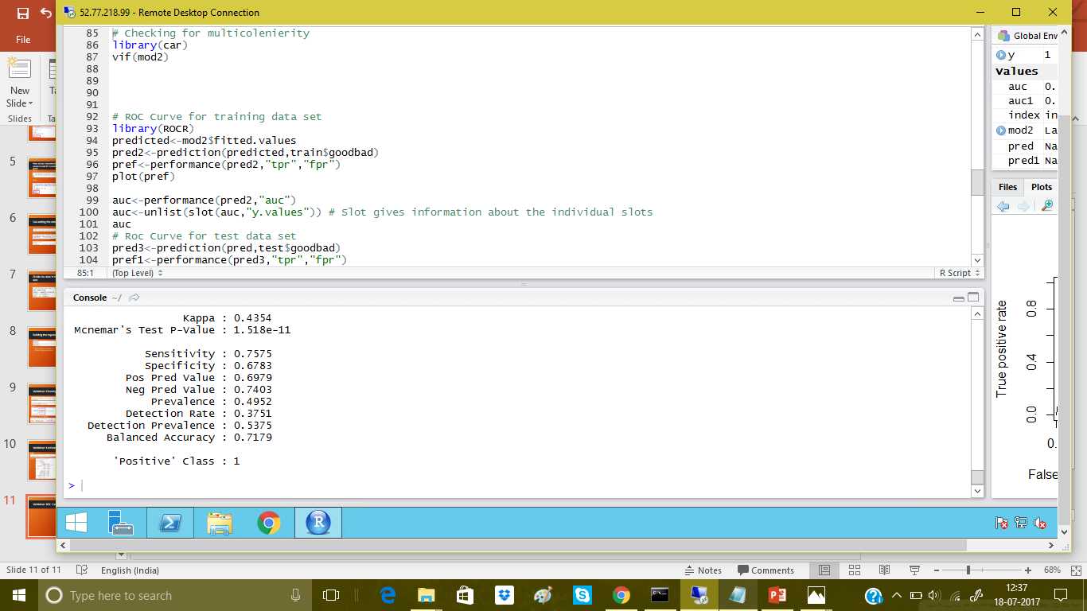
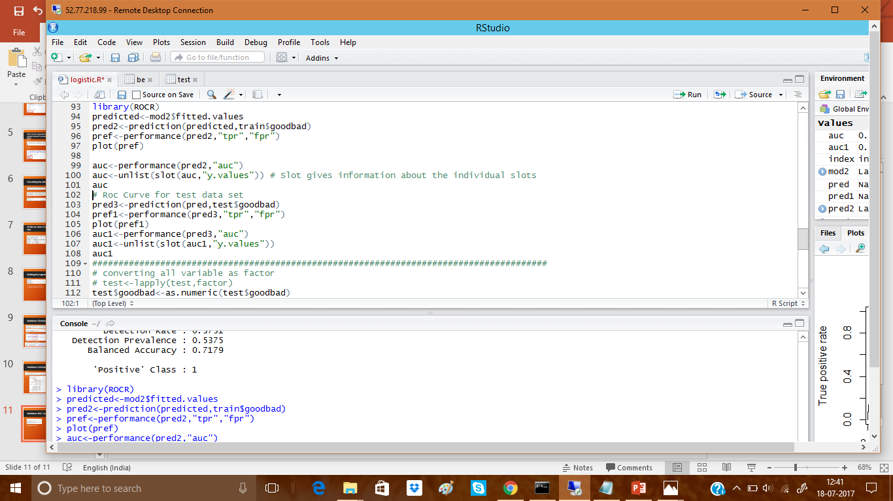
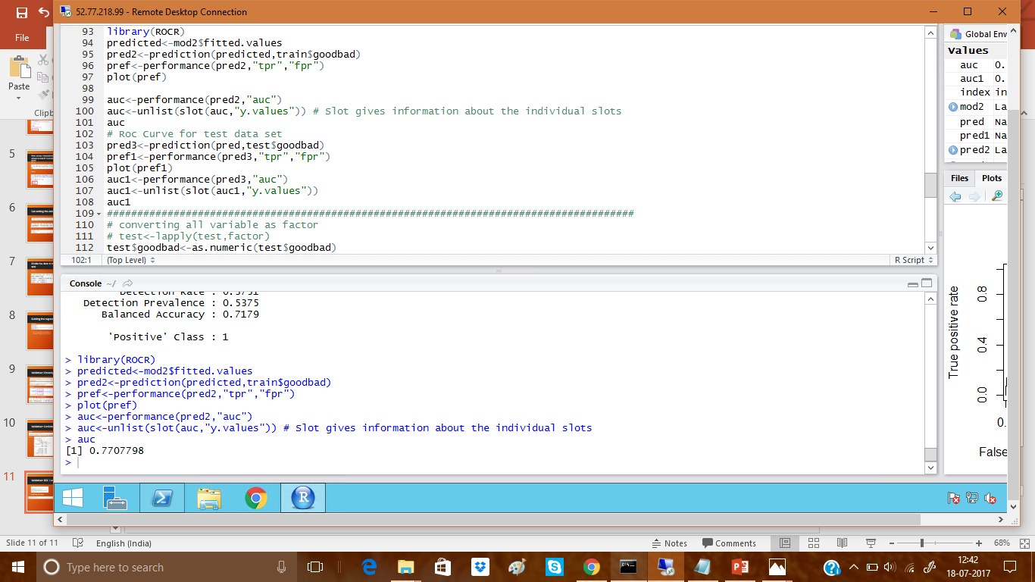
Validation: ROC Curve
Area Under the Curve: 77%
Accuracy: 77%

Slide 19
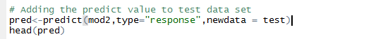

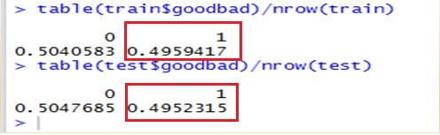
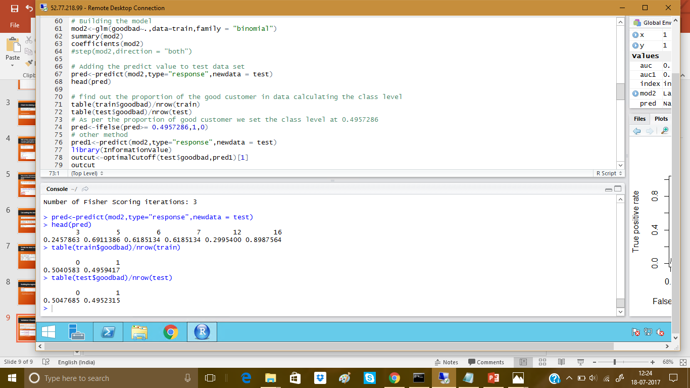
Validation: Choosing the optimal cut off
Output:
Optimal cut off : 0.49522315

Slide 20
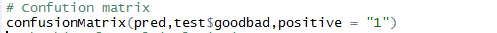
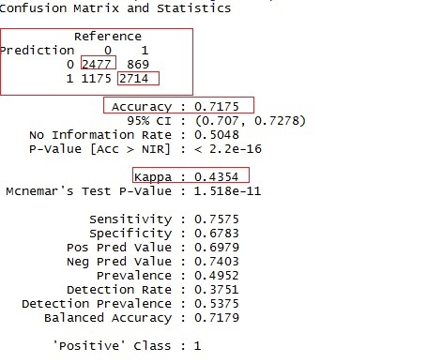
Validation: Confutation Matrix on test data set
Code
Output:
Our model is 71% accurate.

Slide 21

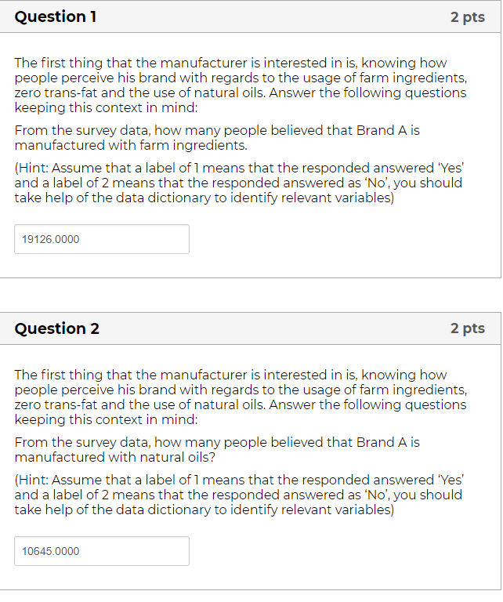

Slide 22
Thank You

